Slide 1
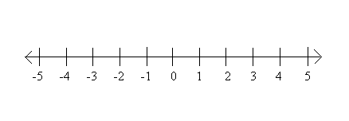
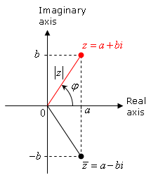
Complex Numbers
Number line – 1 degree of freedom amplitude only
Ohm’s Law
Complex plane – 2 degrees of freedom amplitude and phase
where

Slide 2
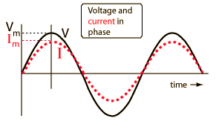
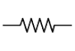
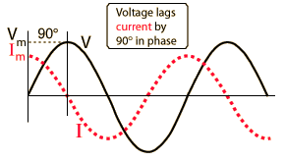

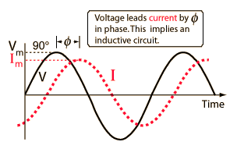

Complex Impedances
Resistor
R
Capacitor
C
Inductor
L
http://hyperphysics.phy-astr.gsu.edu

Slide 3
Complex Impedances
Complex impedances contain information about both amplitude and phase.
Ohm’s Law
In the end, we only consider imaginary part.

Slide 4
Low-pass Filter
High-pass Filter
Band-pass filter
Notch filter

Slide 5
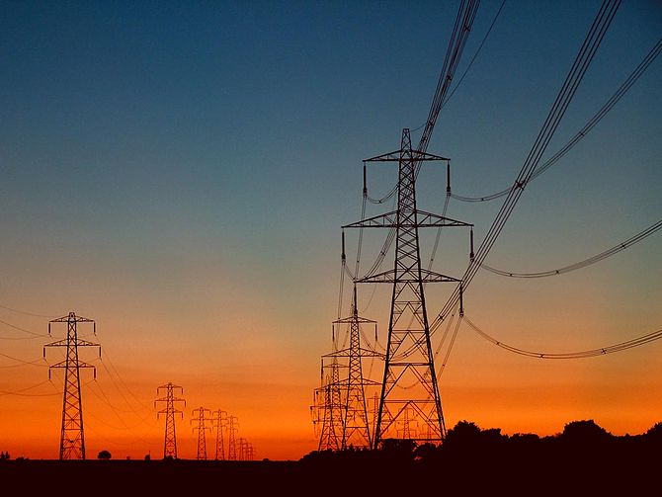
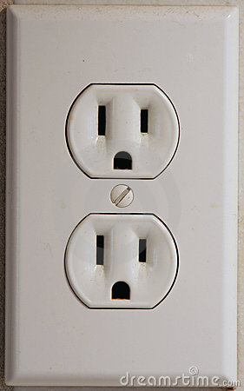
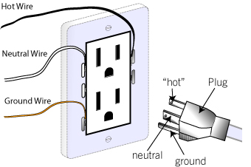
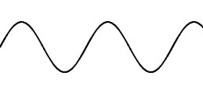
The AC Power Grid
60 Hz, 120 V_{RMS}

Slide 6
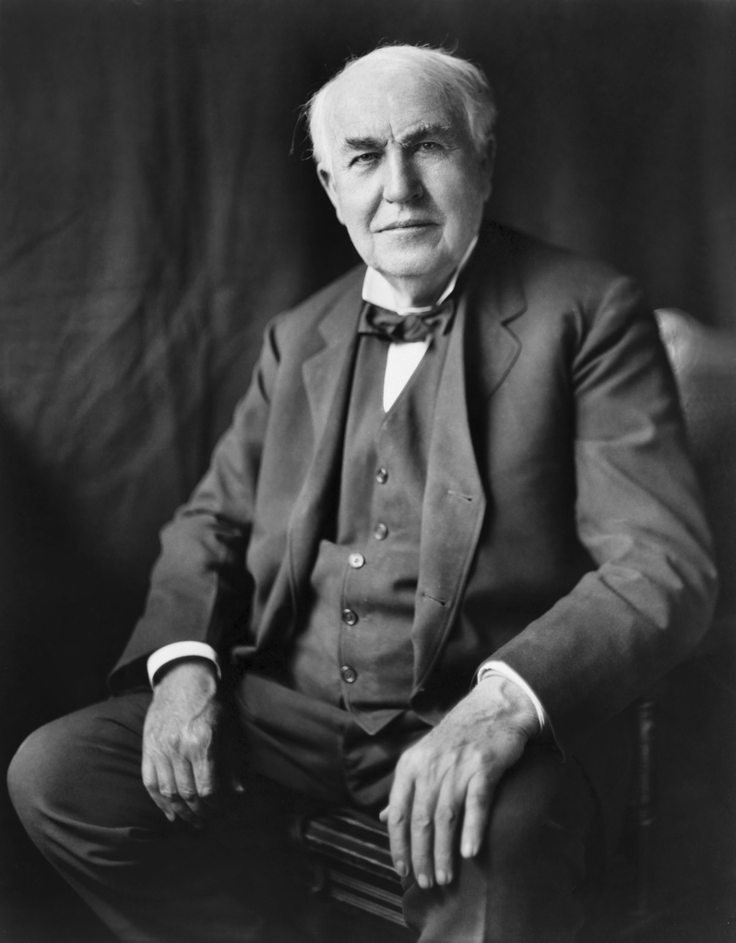
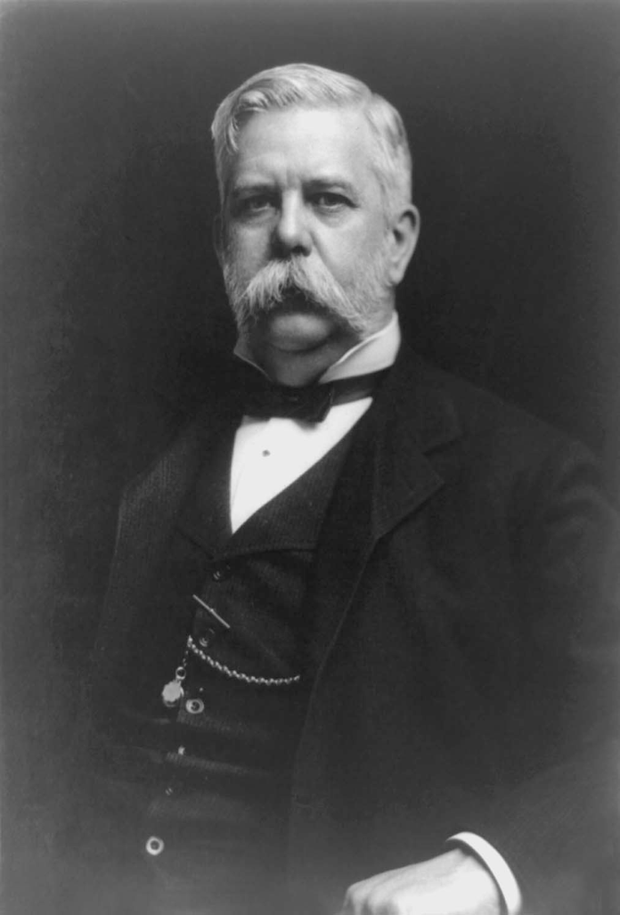


DC vs. AC
In the late 1800s, these two guys fought fiercely over the power grid.
Thomas Edison - DC
Westinghouse - AC
VS.

Slide 7
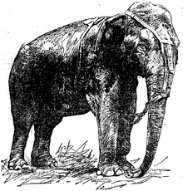


DC vs. AC
Things got ugly!
AC electric chair
Topsy the elephant

Slide 8
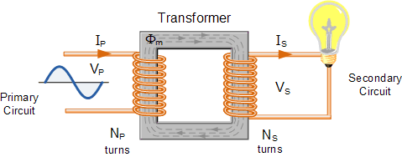
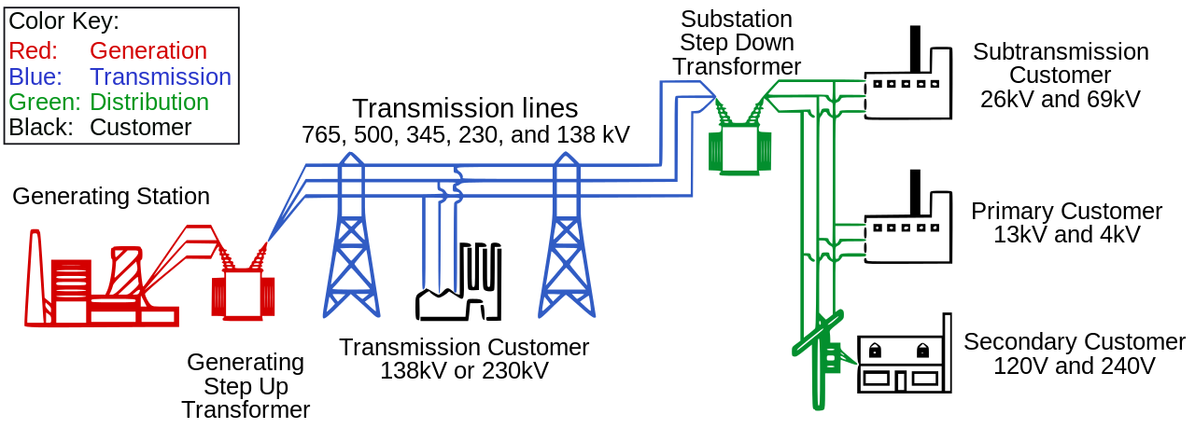
High Voltage Transmission Lines
AC voltages can easily be increased using a transformer.

Slide 9
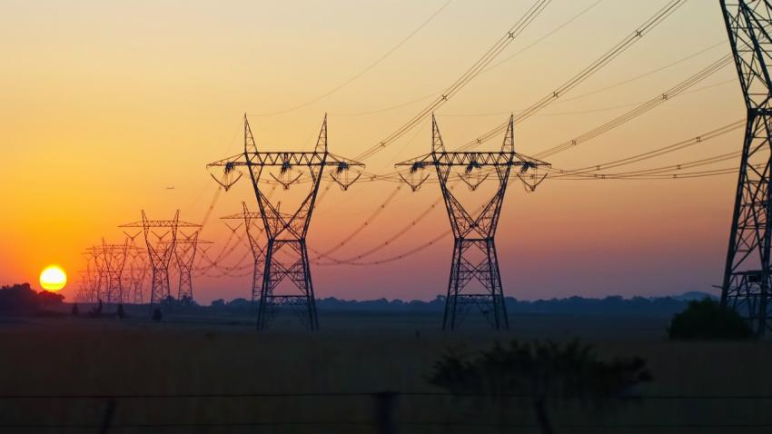
Why did AC win?
Higher voltage = more power!

Slide 10
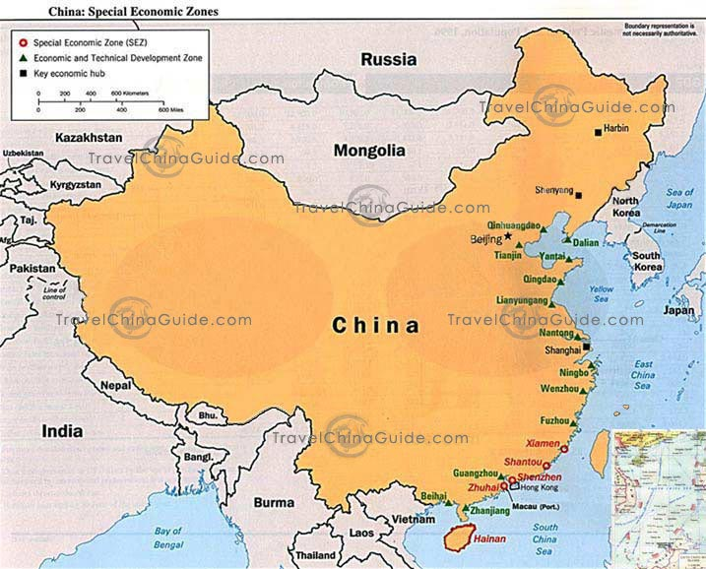
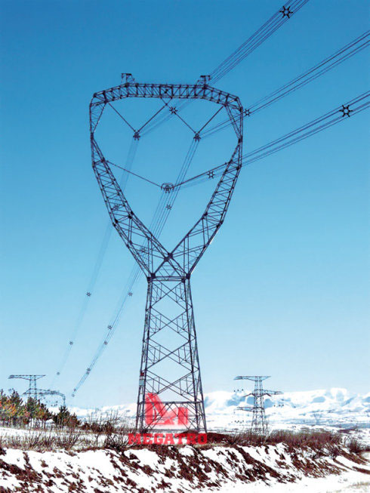
Power Grids of the Future
Power in sent across the country by 1 Million volt transmission lines!
In China, much of the population lives on the east coast.
But most of the energy resources are located in the west.

Slide 11
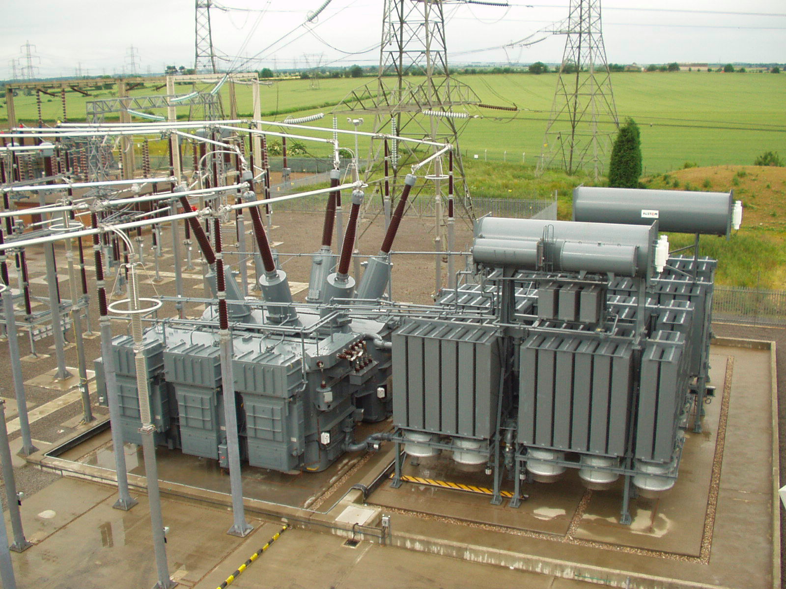
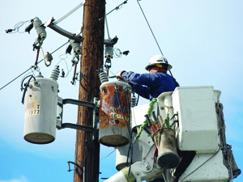
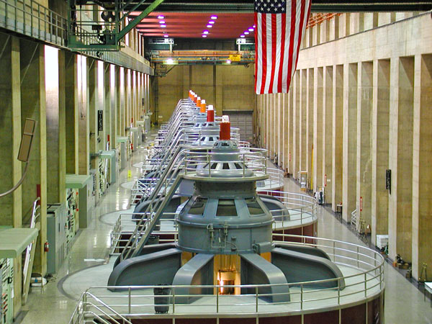
Meanwhile, back in the USA…
Much of the electrical infrastructure in the US is over 50 years old, close to the end of its estimated lifetime.

Slide 12
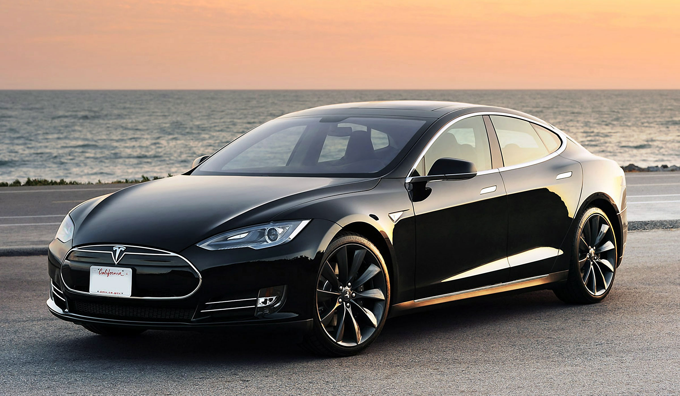
Tesla Models S – All electric, 400 HP

Slide 13
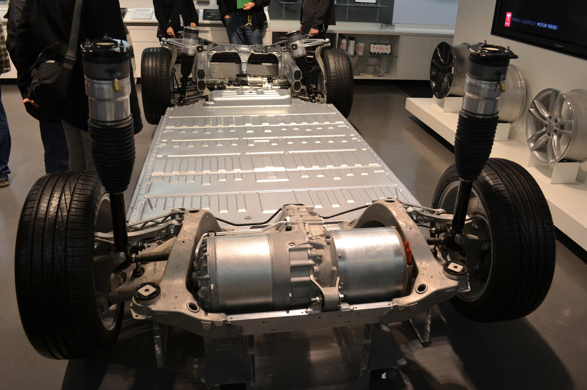
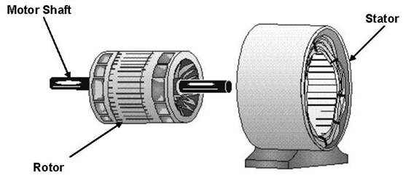
AC Induction Motor – 1,000 Amps at 300 V
300,000 W = 400 HP
Instantaneous torque!
No transmission, no fuel pump, no water pump, no valves… Very few moving parts!

Slide 14
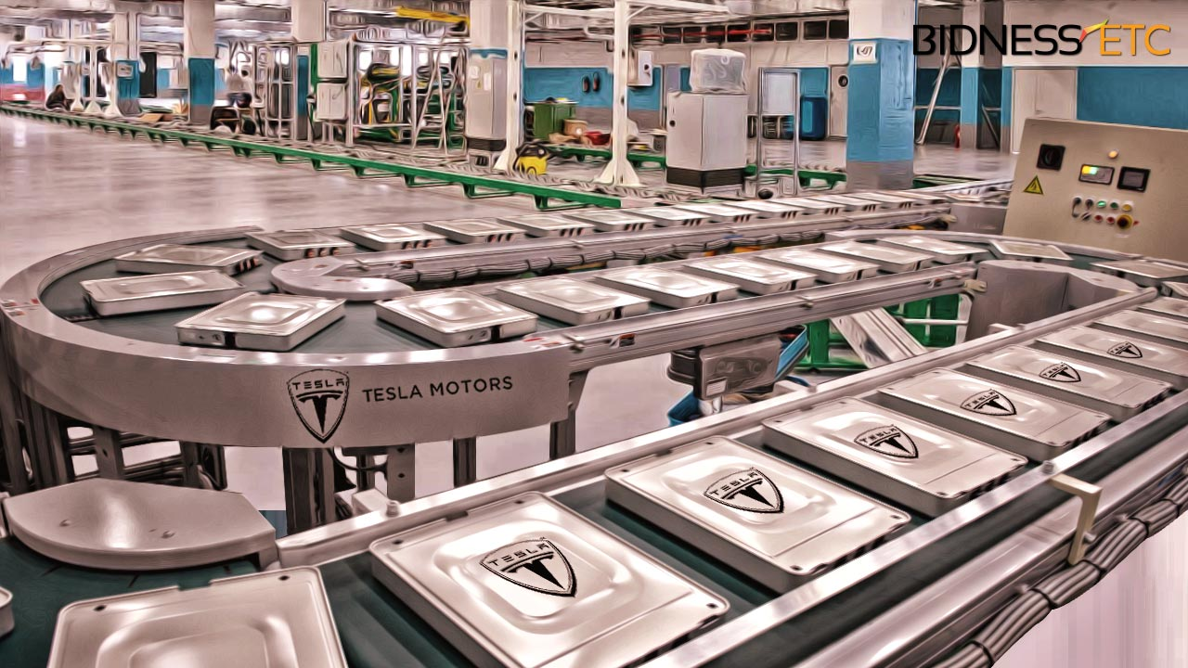
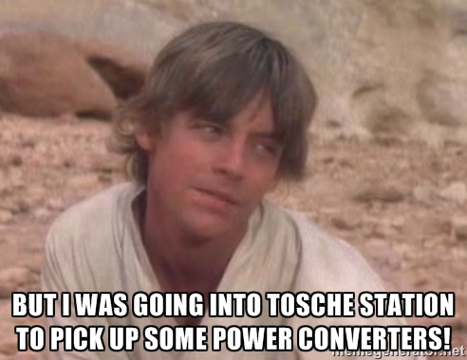
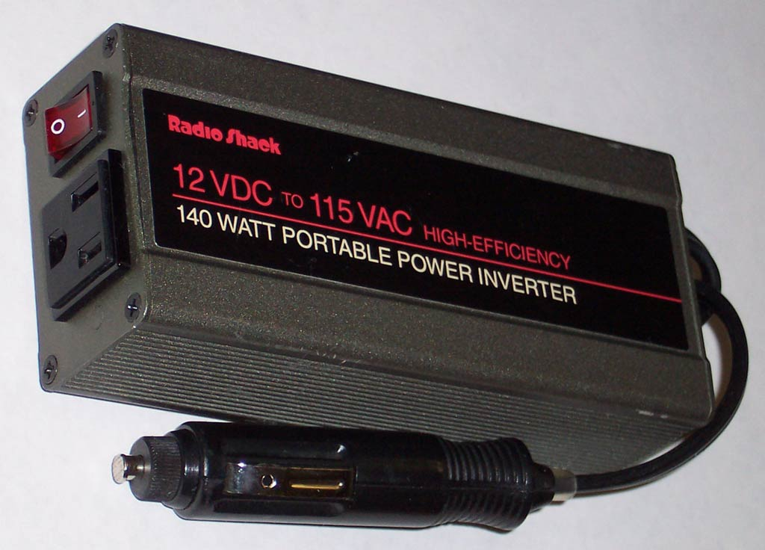
Power Inverter - DC to AC Conversion
Q: Lithium ion batteries are DC, so why not just use a DC motor?
A: DC motors require rare earth magnets.

Slide 15
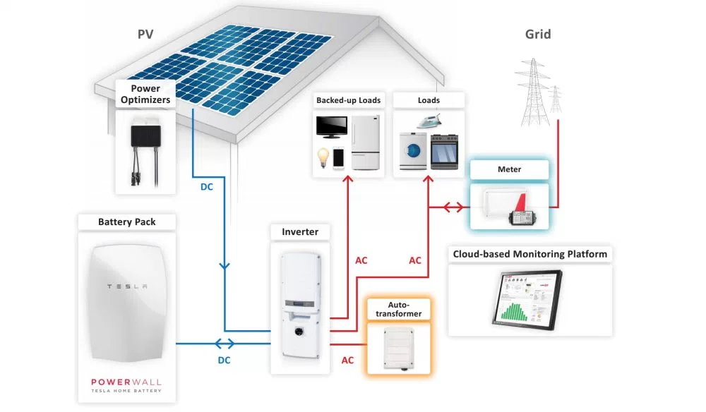
Rooftop Solar
Solar energy is often stored in batteries for use at night.

Slide 16
Solar “Microgrid”
Solar energy is often stored in batteries for use at night.

Slide 17
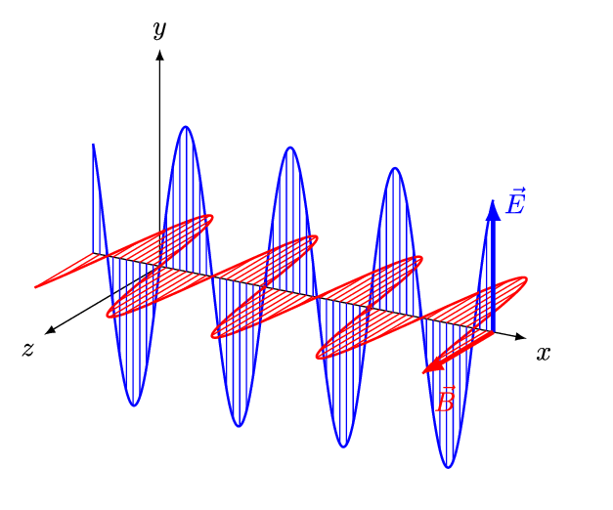
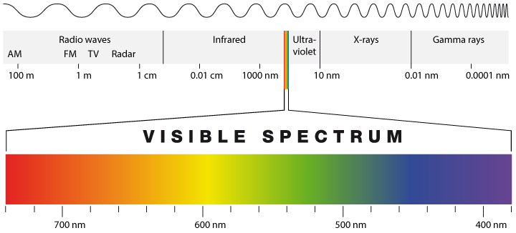
What is Light?
Light is an electromagnetic wave that travels at the speed of light.
“Visible Light” has a wavelength in the 400 – 700nm range.
Wavelength determines color.

Slide 18
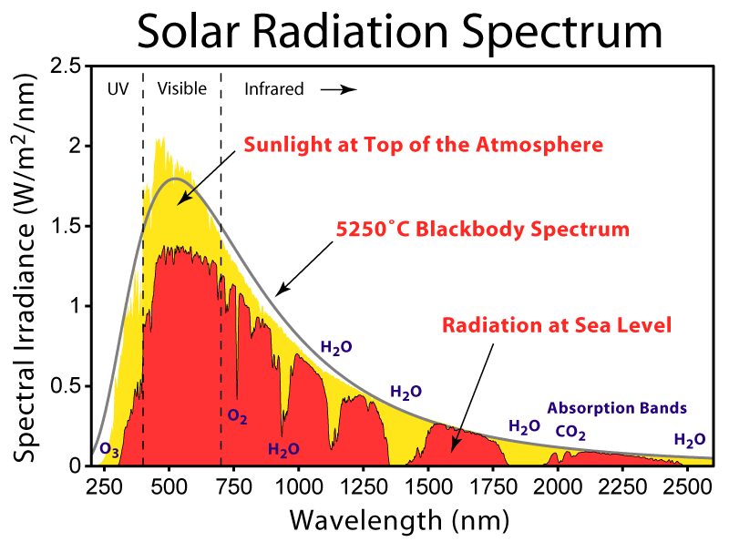

Slide 19
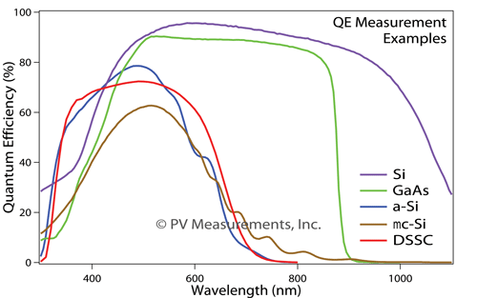
Spectral Response of a Solar Panel
Different types of solar panels are sensitive to different colors of light.
https://www.quora.com

Slide 20
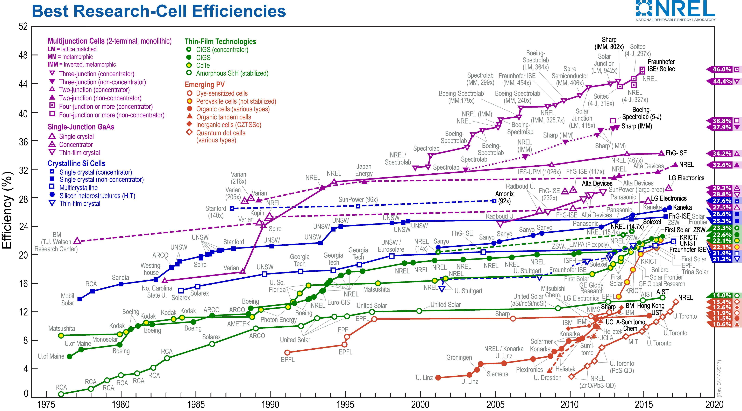
Solar Panel Efficiency
https://www.nrel.gov/pv/assets/images/efficiency-chart.png

Slide 21
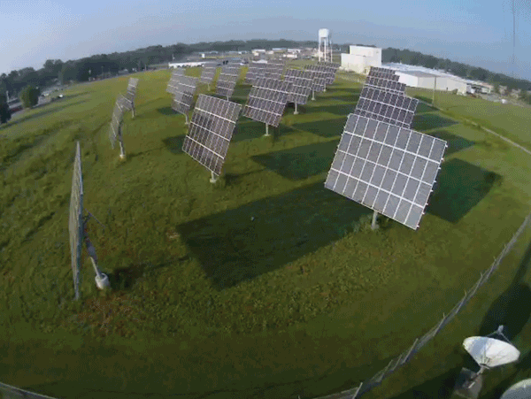
Solar Panel Tilt

Slide 22
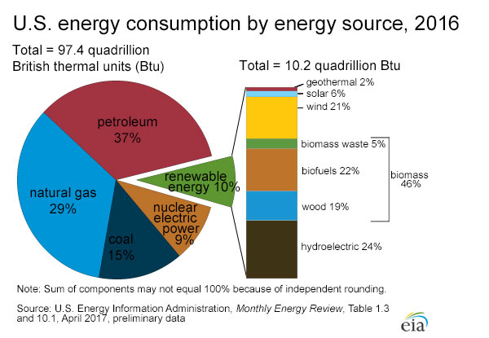
Current Energy Resources

Slide 23
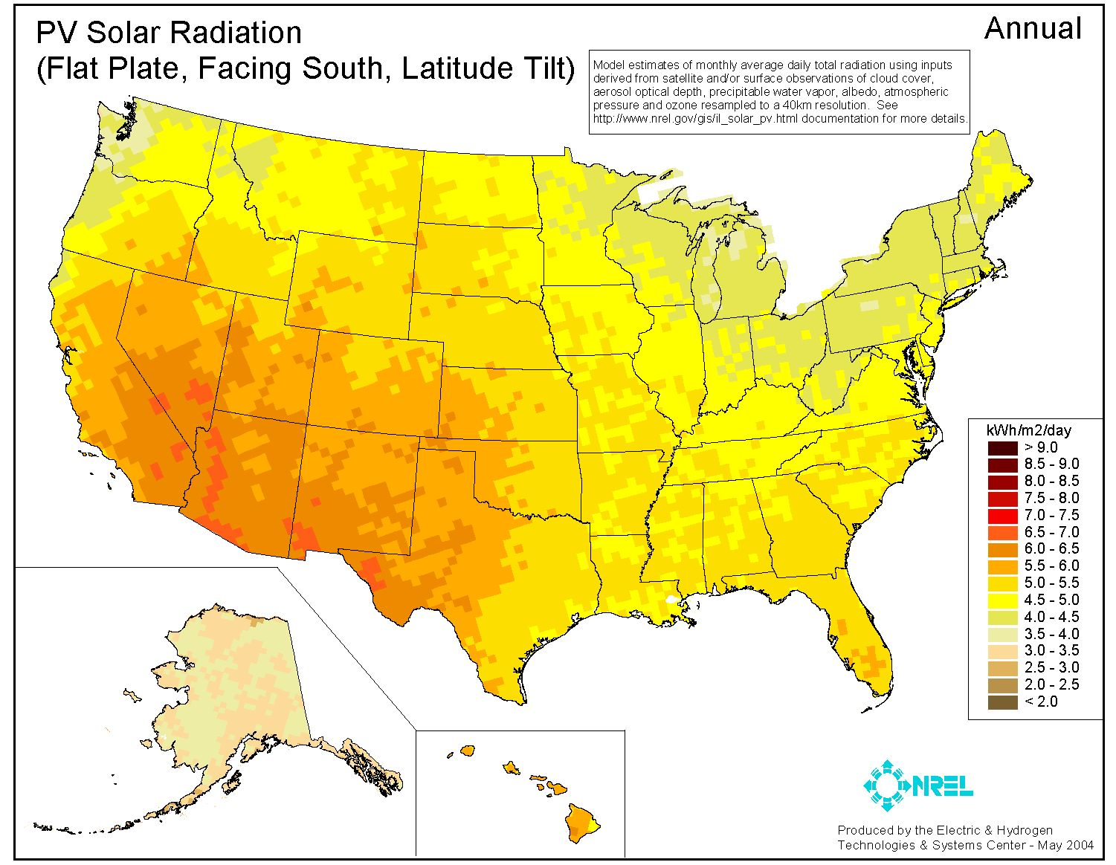

Slide 24
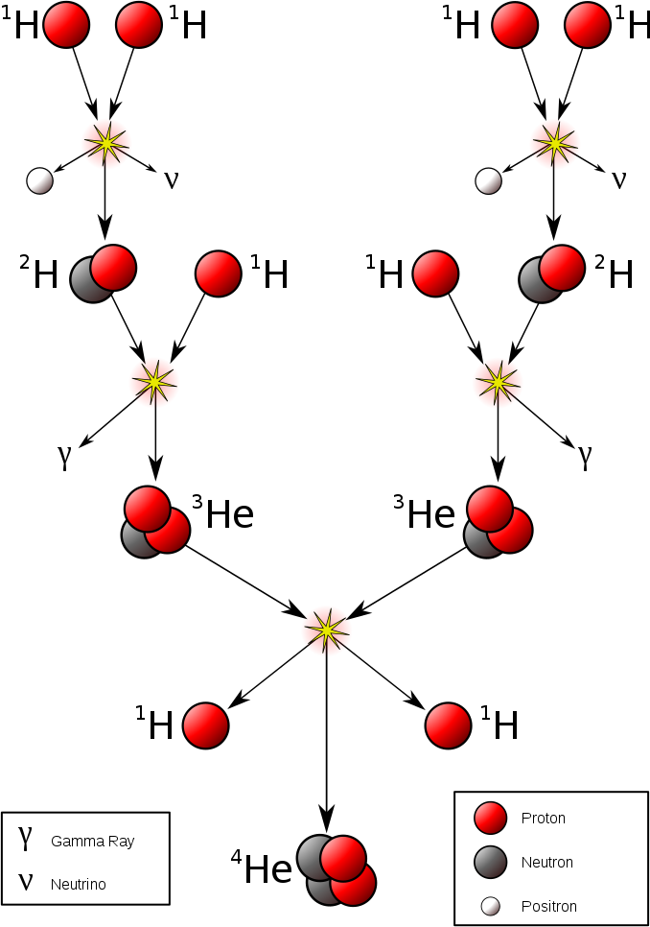
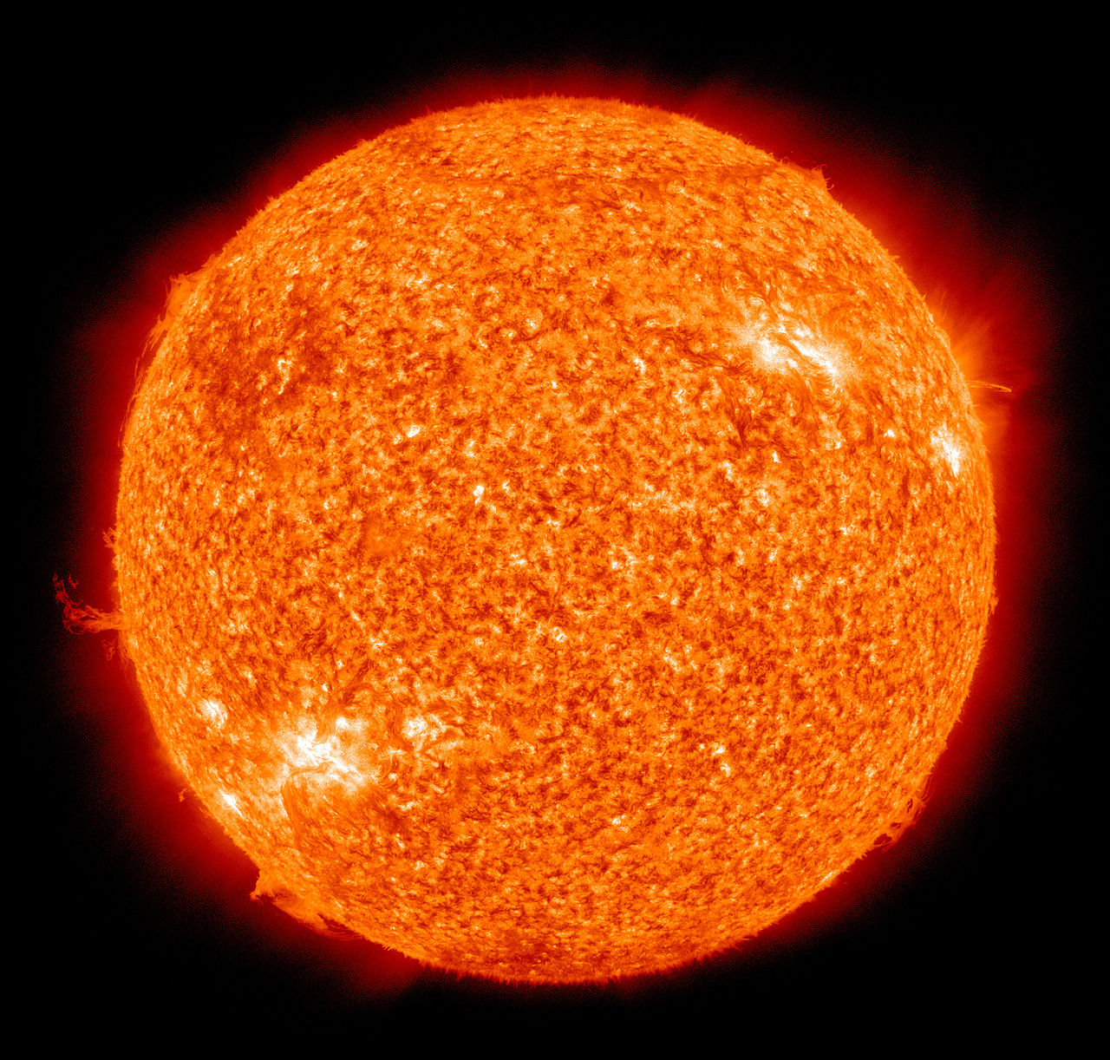
Future Outlook
Solar energy can be traced back to nuclear fusion reactions.
Burning Hydrogen at 10 million degrees fuses it into Helium.
https://en.wikipedia.org/wiki/Nuclear_fusion

Slide 25
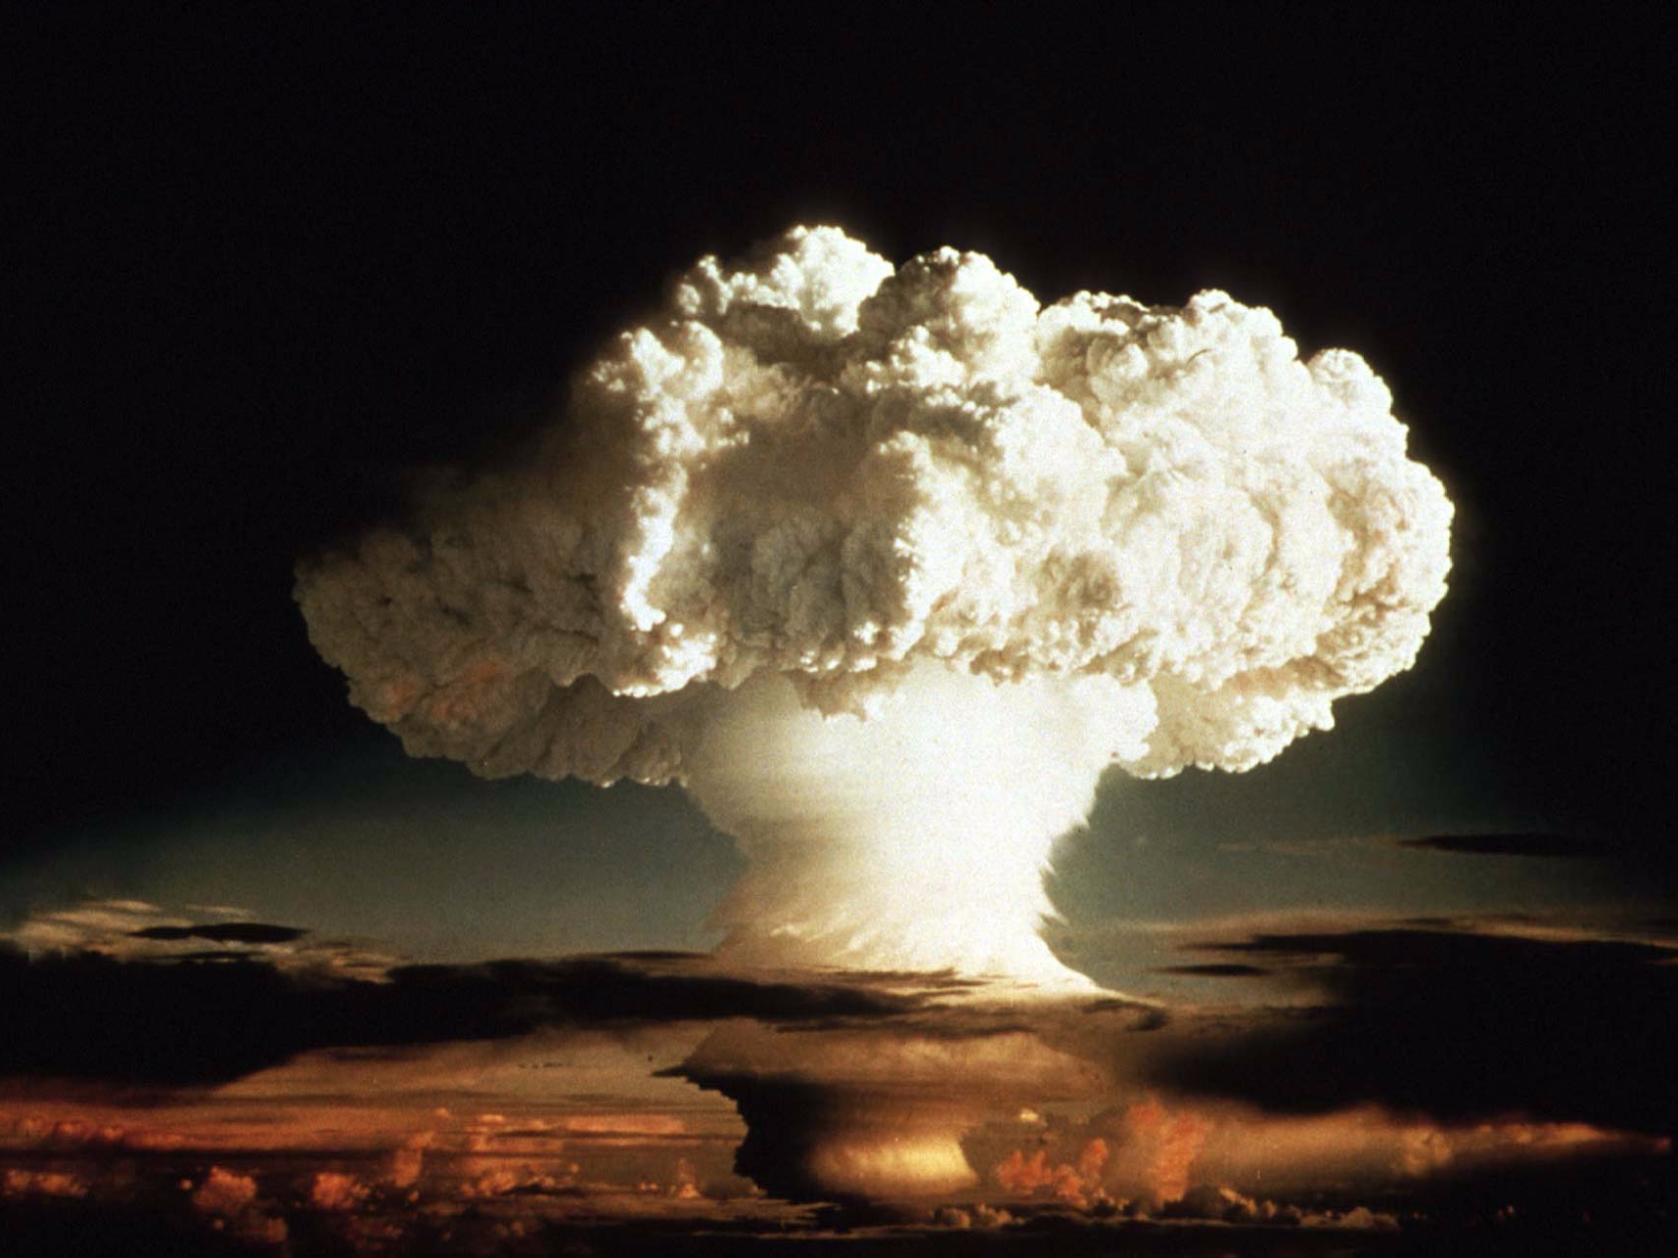
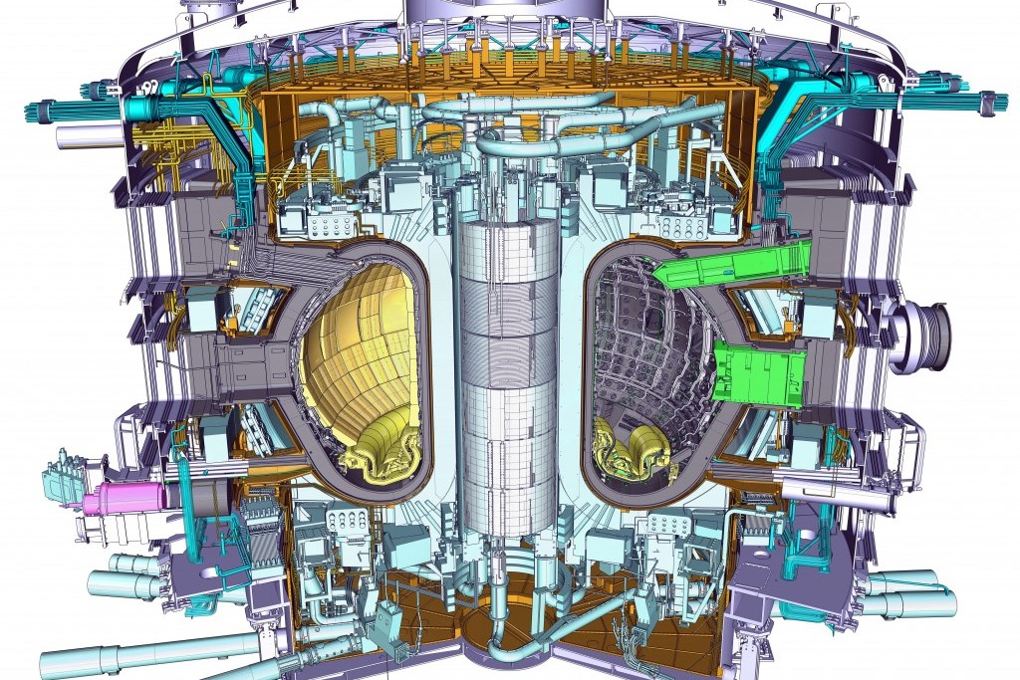
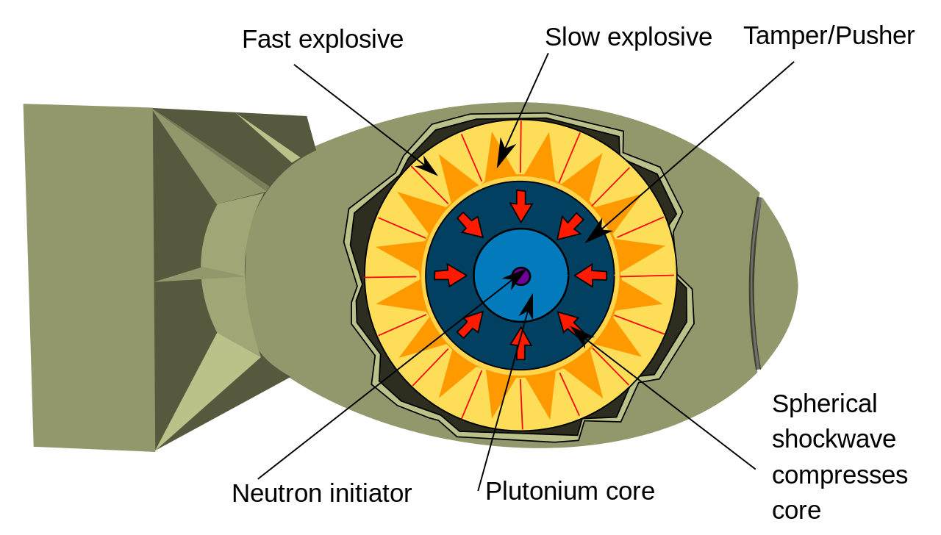
Future Outlook
Fusion energy can be artificially produced in hydrogen bombs.
Scientists are currently trying to harness fusion for peaceful energy production.
https://www.iter.org/proj/inafewlines
http://www.ipp.mpg.de/w7x

